Slide 1
ALGORITHMS PRACTICES

Slide 2
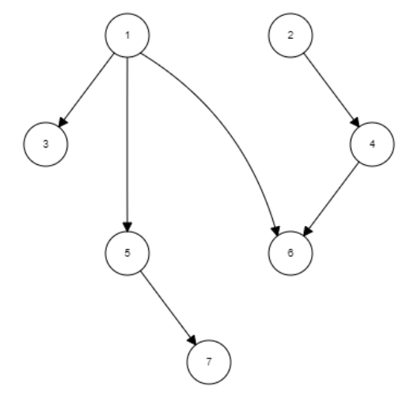
TOPOLOGICAL SORTING

Slide 3
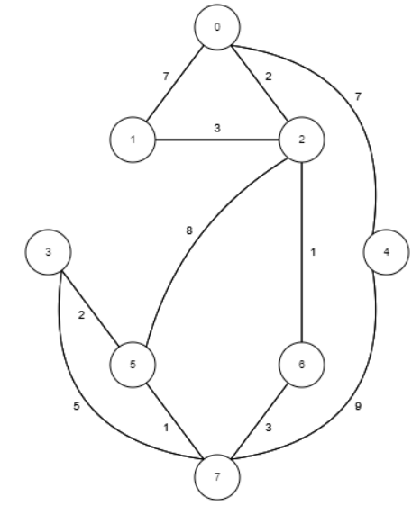
KRUSKAL ALGORITHM

Slide 4
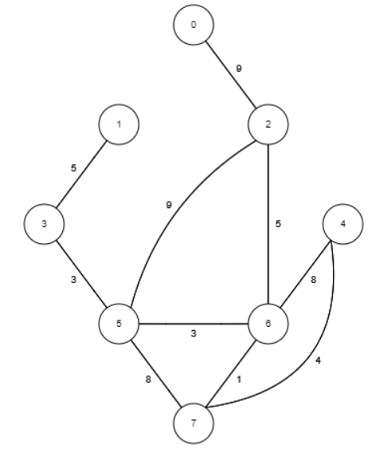
PRIMS ALGORITHM

Slide 6
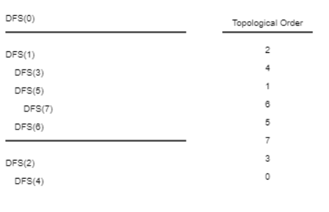

Slide 7
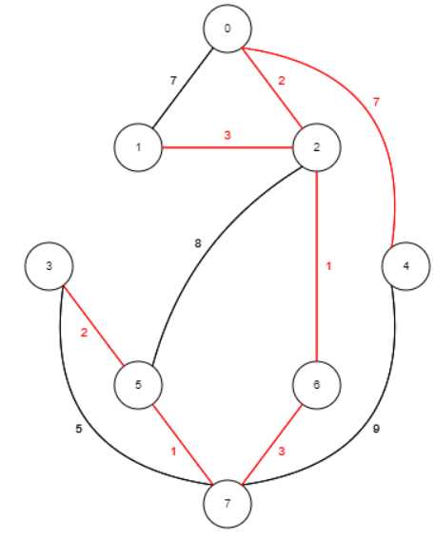

Slide 8
